Slide 1
APL Astronomy Club Meeting
August 21, 2013

Slide 2
Agenda
Treasurer’s report
FY 2014 budget request
Equipment Check-out
Nova Del 2013
Upcoming Events
Observing reports:
  Perseid Meteor Shower: Mark Kochte

Slide 3
APL Astronomy Club Treasury
August 21, 2013
Dues income for CY 2013 21 members have paid dues (16 paid in 2012) New members: Mike Hiteshew (Bldg 13), Mike Dennis (Bldg 6) | $ 500.50
Recent Expenditures None (no reimbursements outstanding) | $ 224.09
Credit Union balance (12 August 2013) | $ 922.13
Rec Office Balance (FY 2013) $1870 was granted All items in original budget have been purchased. | $ 0.00

Slide 4
FY 14 Budget Request
Description | Expected Cost | Requested APL Funding | Champion
8" Optical Tube Assembly (OTA) with right-angle finder | $1,000.00 | $800.00 | Dave T.
8" OTA case | $180.00 | $144.00 | Dave T.
Right-angle finder scope for 8" OTA* | $100.00 | $80.00 | Dave T.
Equatorial mount | $800.00 | $640.00 | Dave T.
Sky-Watcher AllView mount for H-alpha Lunt telescope | $399.00 | $319.20 | Ron F.
Zoom eyepiece for Lunt Ca-K telescope | $149.00 | $119.20 | Ron F.
Filter set* | $160.00 | $128.00 | Dave T.
Illuminated reticle eyepiece* | $100.00 | $80.00 | Dave T.
Case for Orion 8" telescope | $90.00 | $72.00 | Dave T.
15x70 Celestron binoculars* | $90.00 | $72.00 | Dave T.
JMI counterweight set* | $80.00 | $64.00 | Dave T.
Telrad finder | $40.00 | $32.00 | Dave T.
Observer's handbook 2014 | $38.20 | $30.56 | Mark K.
Turn Left at Orion - Book | $30.00 | $24.00 | Mark K.
TOTAL COSTS: | $3,256.20 | $2,604.96
* = lower priority items

Slide 5

Equipment Check-out
We are in the processes of revamping our procedure for checking out club equipment.
To the right is a draft of our new check-out form.
Equipment room key-holders will need to sign off on check-outs and “parking lot” exchanges.
Current key-holders:
Steve Conard
Dan Smith
Helen Hart
Mark Kochte

Slide 6
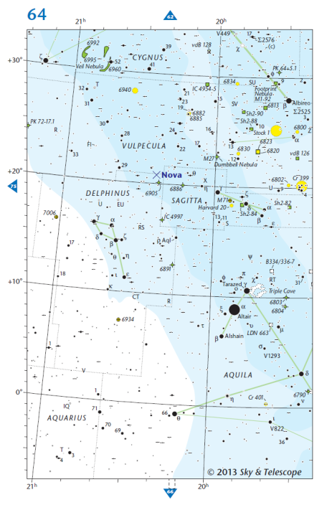
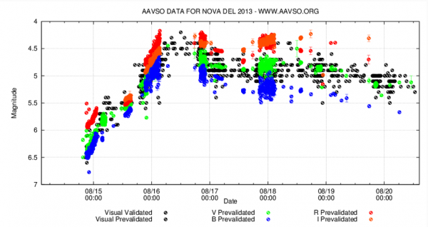
Nova Del 2013
(left) Sky and Telescope Finder Chart
(bottom) http://www.aavso.org/whats-store-nova-del-2013

Slide 7
Upcoming Events – APL Club
Next Club Meeting – September 18, 2013
Possible Solar Observing Session – September 17, 2013
Friends and Family Star Party – October 11, 2013

Slide 8
Upcoming Events - Regional
Spoutwood Summer Solstice Star Party – Aug. 30, 2013 (next Friday) – Glen Rock, PA
NOVAC AHSP- Sept. 6-10, 2013 - Spruce Knob, WV
Black Forest Star Party- Sept. 6-8, 2013 - Central Pennsylvania Observers - Cherry Springs State Park, Potter County, PA
HAL Public Star Party – Sept. 28, 2013 – Alpha Ridge Park, Marriottsville, MD
Blackwater Falls State Park Star Party – Sept.27-29, 2013 – Blackwater Falls State Park, Davis, WV
Chaos Fall Star Party – Oct. 1-6, 2013 - Staunton River State Park - Near Scottsburg, Virginia
No Frills – Oct. 3-6, 2013 - Delmarva Star Gazers
Tuckahoe State Park's Equestrian Center, Queen Anne, MD

Slide 9
Observing Reports

